Slide 1

Introduction to Bacteriology
2nd Year – 1st semester
Dr. Munira Ch. Ismail

Slide 2
Learning Objectives
Shapes of bacteria
Structure of bacterial cell
Different ion between Gram positive and Gram negative bacteria cell envelope
Cell wall
Chemical composition of the cell wall
Special components of Gram negative cell wall
Special components of Gram positive cell wall
Cytoplasmic ultra structures

Slide 3
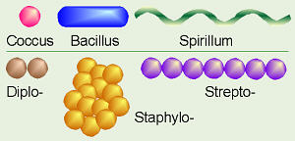
1. Shapes of bacteria

Slide 4
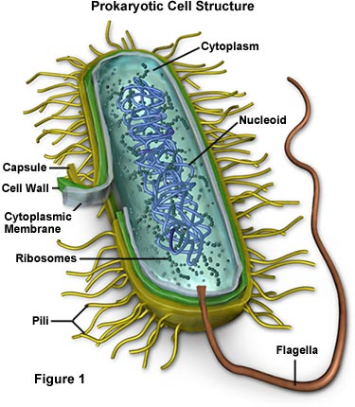
2. Structure of bacterial cell

Slide 5
3. Cell envelope
Gram positive bacteria
Thick layer of peptidoglycan (PG)
2 to 3 layers of cytoplasmic membrane
Capsule (some bacteria)
Gram negative bacteria
Outer membrane
peptidoglycan (PG) (single layer)
cytoplasmic membrane (inner membrane)
Capsule (some bacteria)
Periplasmic space (between outer and inner membrane

Slide 6
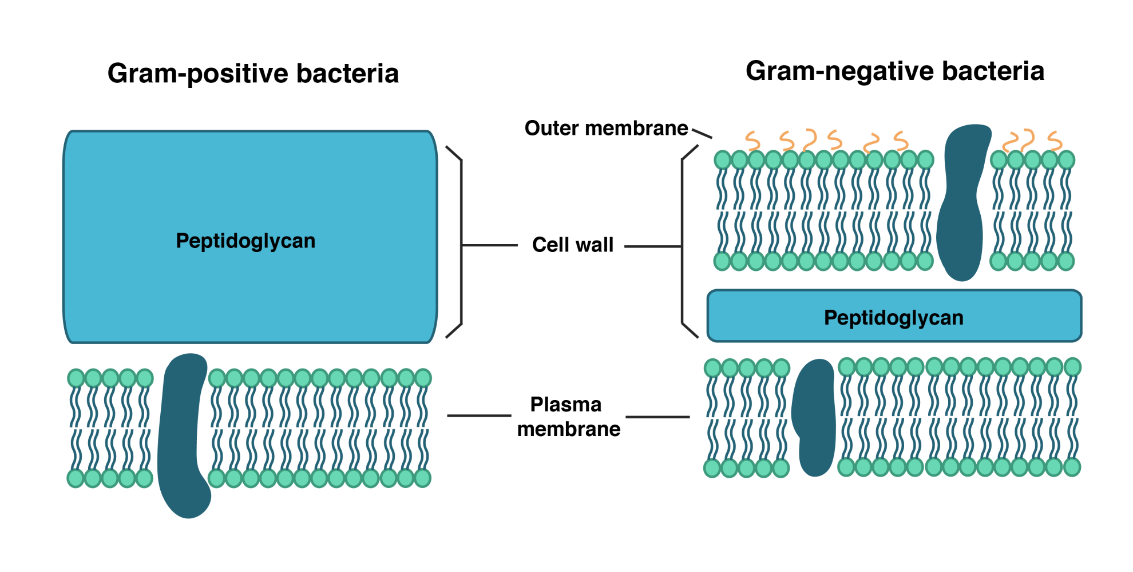
Different ion between Gram positive and Gram negative bacteria cell wall
Cell envelope

Slide 7
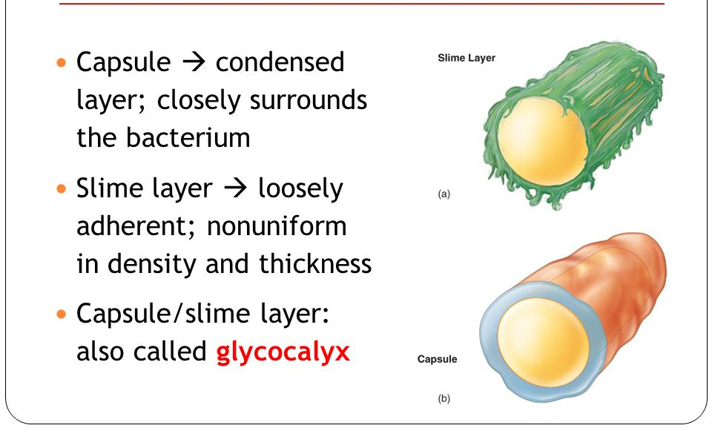
Extracellular polysaccharide

Slide 8
4. Cell wall composition
Gram positive cell wall composition
Peptidoglycan
Teichoic acid
Polysaccharides
Gram negative cell wall composition
- Peptidoglycan
- Outer membrane:
  Lipoprotein
  Lipopolysaccharide (LPS)

Slide 9
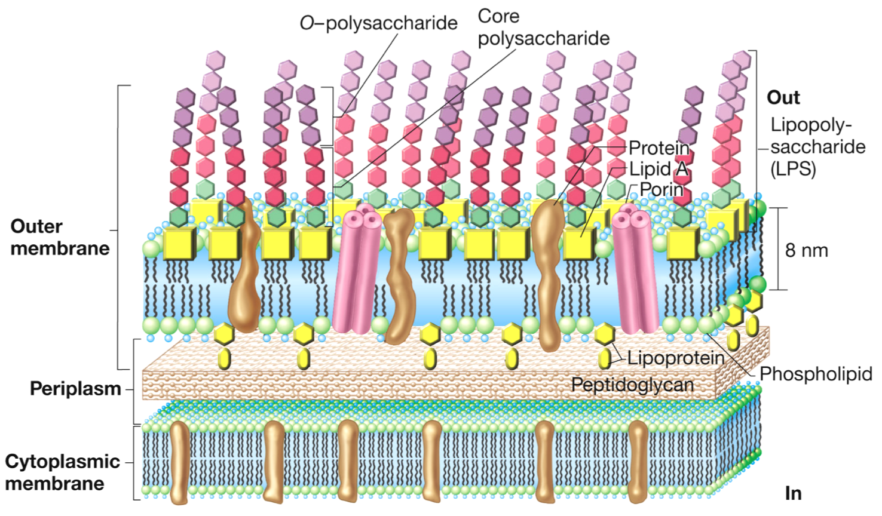
Outer membrane in cell wall of gram negative bacteria

Slide 10
5. Chemical composition of the cell wall
Peptidoglycan layer: 3 components
Backbone (repeated subunit of N-acetyl glucosamine and N-acetyl muramic acid linked by β-glycosidic bond)
Tetra-peptide side chain ( chain of 4 amino acids) linked to N-acetyl muramic acid
Peptide cross linkage

Slide 11
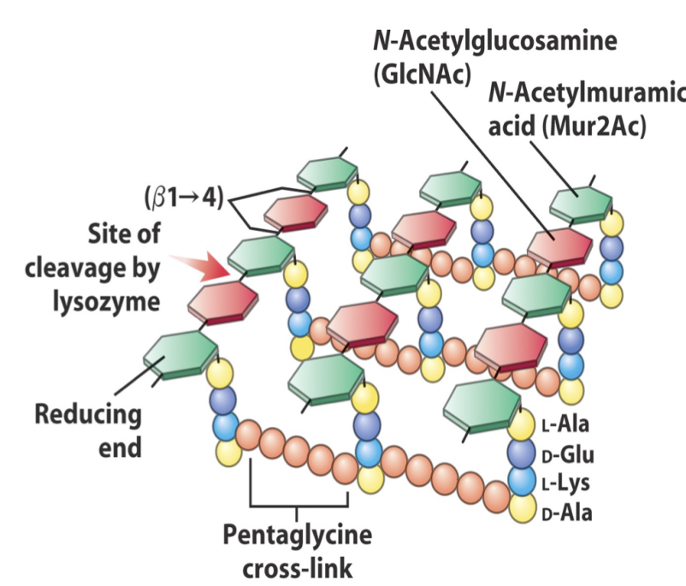
Peptidoglycan structure.

Slide 12
Tetra-peptide side chain
The amino acids found in tetra-peptide are:-
L-alanine: 1st position in both gm+ve and gm-ve bacteria
D-glutamin: 2nd position
D-aminopimelic acid/ L-lysine: 3rd position (variation occurs)
D-alanine: 4th position

Slide 13
Home Work 1
Differentiation between Prokaryotes and Eukaryotes

Slide 14

Any Questions?

